Slide 1
Real Time Image Animation
Mis6
Batch A_ Team 11

Slide 2
Team Members
01
J R S Ajay Surya Narayana Raju
CB.EN.U4AIE21018
02
Mohitha Velagapudi
CB.EN.U4AIE21032
GROUP 11
03
M Prasanna Teja
CB.EN.U4AIE21035
04
Pinninti Sai Ravula
CB.EN.U4AIE21041

Slide 3
Content
Abstract & Introduction
Methodology
01
02
Explaining the framework
What is Image Animation?
Codes
Results
Implementation of our methodology
04
03
Simulation of Results and conclusion

Slide 4
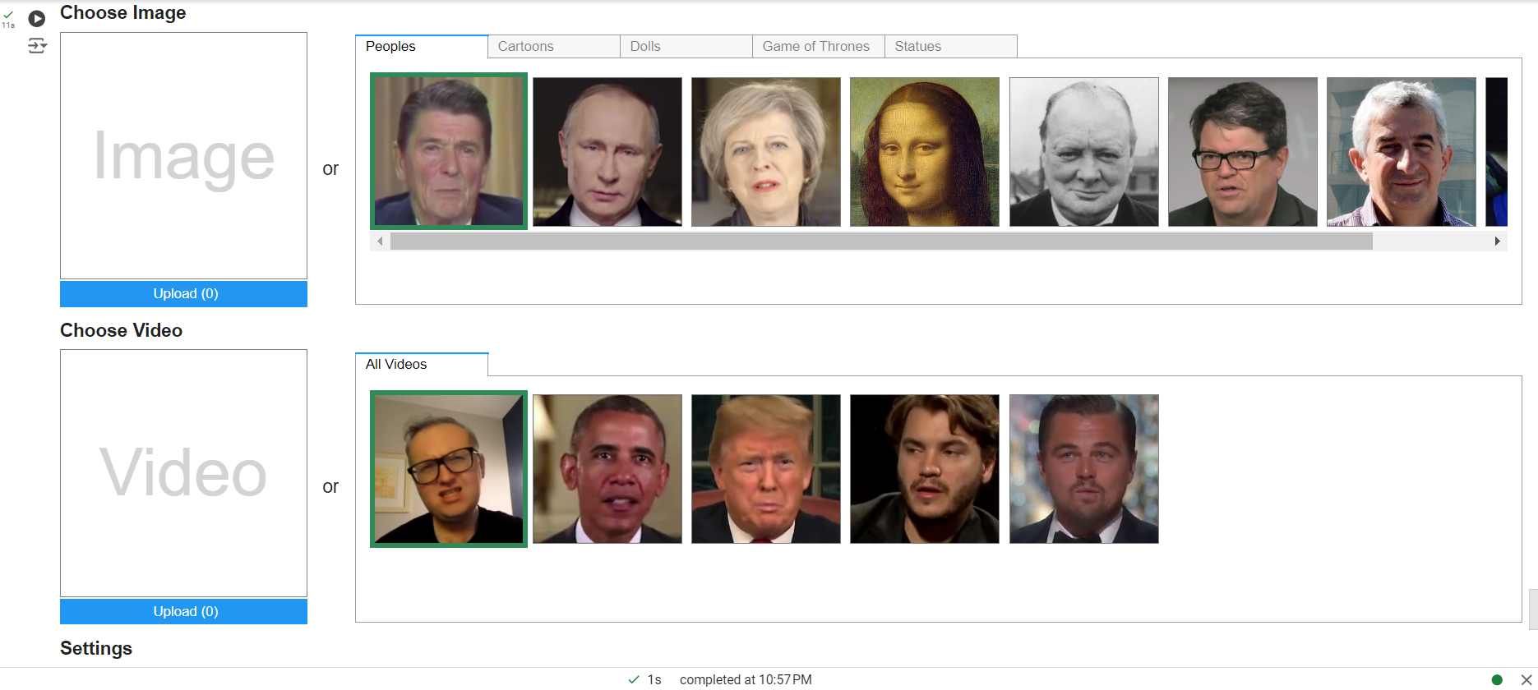
Interface

Slide 5
Introduction
Image Animation
Image animation refers to the task of automatically synthesizing videos by combining the appearance extracted from a source image with motion patterns derived from a driving video.
Our frame work addresses this problem without using any annotation or prior information about the specific object to animate.
Once trained on a set of videos depicting objects of the same category (e.g. faces, human bodies), our method can be applied to any object of this class.

Slide 6
Introduction
Image Animation
To support complex motions, we use a representation consisting of a set of learned keypoints along with their local affine transformations.
A generator network models occlusions arising during target motions and combines the appearance extracted from the source image and the motion derived from the driving video

Slide 7
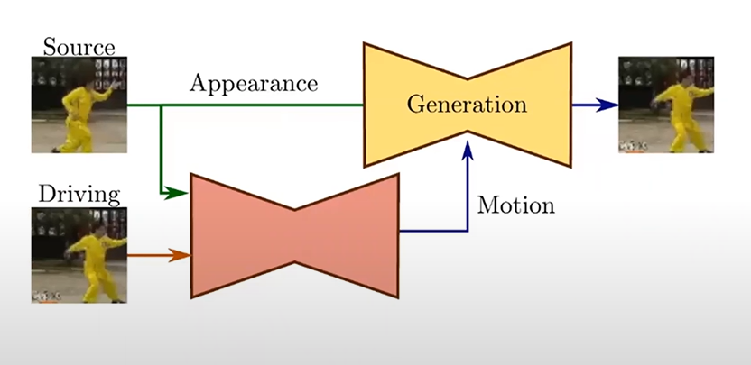
Training phase
Self – supervised training :
Our model is trained to reconstruct the training videos by combining a single frame and a learned latent representation of the motion in the video. Observing frame pairs, each extracted from the same video, it learns to encode motion as a combination of motion-specific keypoint displacements and local affine transformations.

Slide 8
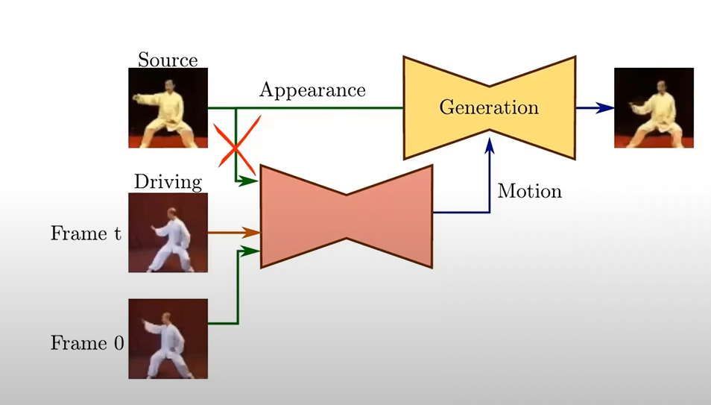
Test time
At test time we apply our model to pairs composed of the source image and of each frame of the driving video and perform image animation of the source object

Slide 9
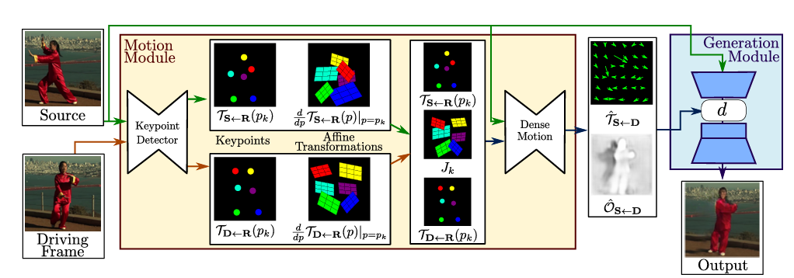
Overview of our approach
Our method assumes a source image S and a frame of a driving video frame D as inputs. The unsupervised keypoint detector extracts first order motion representation consisting of sparse keypoints and local affine transformations with respect to the reference frame R. The dense motion network uses the motion representation to generate dense optical flow TS D from D to S and occlusion map OS D. The source image and the outputs of the dense motion network are used by the generator to render the target image.

Slide 10
Motion Estimation module
Key point Detector : Keypoints + Local Affine Transformations
Key Points :The locations of the keypoints in D and S are separately predicted by an encoder-decoder network. The keypoint representation acts as a bottleneck resulting in a compact motion representation.
Affine Transformation : The keypoints of the source image can be moved using the keypoints trajectories in the driving video. We model motion in the neighborhood of each keypoint using local affine transformations.

Slide 11
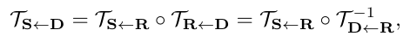
Local Affine Transformation
Approximation of TS ← D
Reference frame :
We assume there exists an abstract reference frame R.
We independently estimate two transformations: from R to S (TS← R) and from R to D (TD← R).
This is never explicitly computed and visualized
Zk
pk
Zk
TS←R(pk)
TR←D (zk)

Slide 12
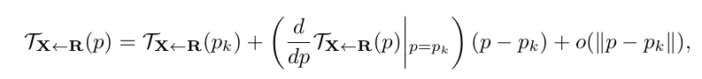
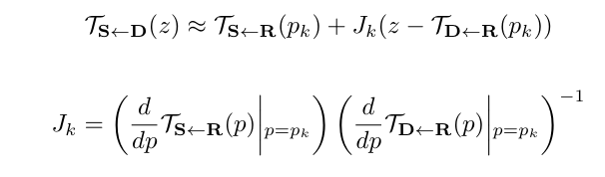
Local Affine Transformation
Zk
pk
Given a frame X, we estimate each transformation
TX←R in the neighbourhood of the learned keypoints.
Formally, given a transformation TX←R, we consider its first order Taylor expansions in K keypoints p1…. pK.
X,S,D
R
P : point locations in reference pose space
Z : point locations in X, S, D space
After computing again the first order Taylor expansion for the above Equation

Slide 13
Motion Estimation module
Dense Motion network
It combines the local approximations to obtain the resulting dense motion field TS←D.
Furthermore, in addition to the dense motion field, this network outputs an occlusion mask OS← D that indicates which image parts of D can be reconstructed by warping of the source image and which parts should be inpainted, i.e. inferred from the context.

Slide 14
Generator Network
Occlusion Handling
The source image S is not pixel-to-pixel aligned with the image to be generated D.
Misalignment issue
Use feature warping strategy
After two down-sampling convolutional blocks, we obtain a feature map of dimension H’ x W’
The occluded parts in S cannot be recovered by image-warping and thus should be inpainted
Consequently, we introduce an occlusion map to maskout the feature map regions that should be inpainted.
Thus, the occlusion mask diminishes the impact of the features corresponding to the occluded parts

Slide 15
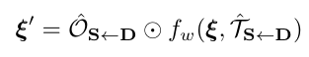
Generator Network
The transformed feature map is written as:
where
fw( .,.) denotes the back-warping operation
denotes the Hadamard product.
: feature map

Slide 16
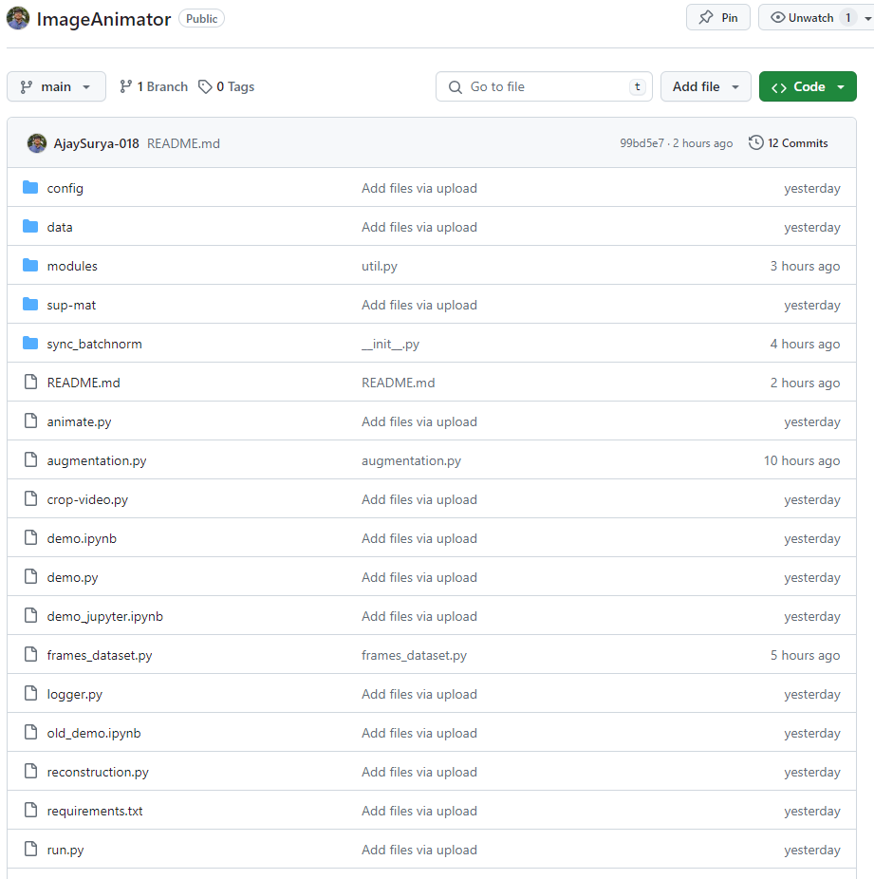
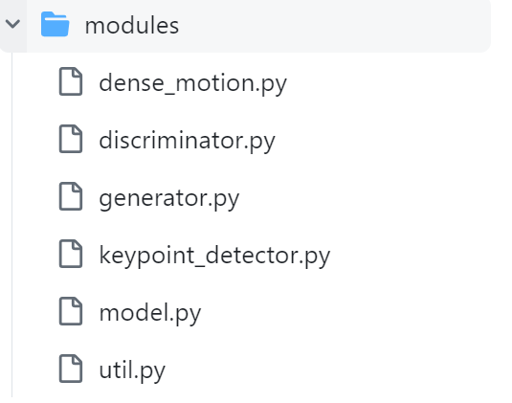
Implementation
Our GITHUB repository for this project is shown here.

Slide 17
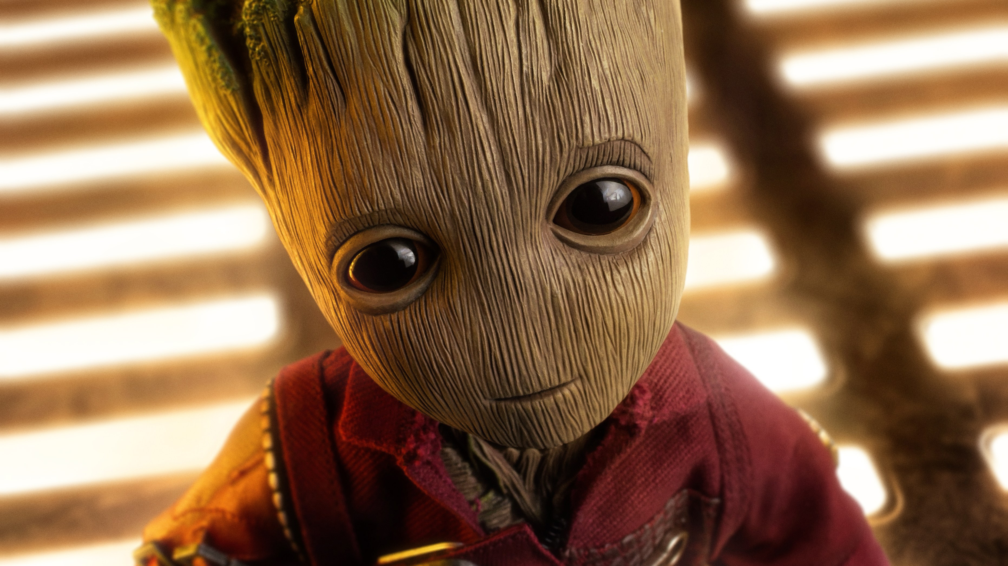
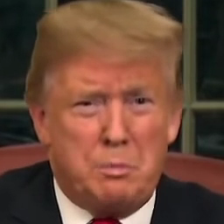
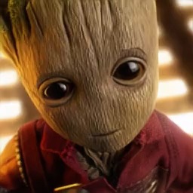
Results
Source Image
Driving Video
Result

